Slide 1
Twitter Sentiment Analysis using NLP Date: 28th June, 2025 Prepared by: PAROMITA SAHA

Slide 2
Agenda
Introduction
Project Aim & Goal
Project Objective
Methodology: An NLP-Driven Approach
Data Collection
Data Pre-processing & Cleaning
Sentiment Analysis Technique
Key Findings & Visualizations
Conclusion

Slide 3
Introduction
This report outlines a project focused on Twitter Sentiment Analysis, with a strong emphasis on the application of Natural Language Processing (NLP) techniques. In today's digital age, social media platforms like Twitter serve as vast repositories of public opinion. Understanding and analyzing this sentiment is crucial for businesses, researchers, and policymakers to gauge public perception, track trends, and make informed decisions. This project aims to automatically classify the sentiment of tweets and extract meaningful insights from textual data.

Slide 4
Project Aim & Goal
The purpose of this Twitter Sentiment Analysis project is to:
Automatically classify the sentiment of tweets and extract meaningful insights from textual data.
This is crucial for businesses, researchers, and policymakers to:
Gauge public perception.
Track trends.
Make informed decisions.
The project aims to achieve this through:
Data acquisition and preprocessing (cleaning and normalizing text).
Sentiment classification using NLP techniques.
Trend identification and shifts in public opinion.
Key topic extraction correlated with sentiment.
Influencer identification.
Visualization of these insights.

Slide 5
Project Objective
The primary objectives of this Twitter Sentiment Analysis project are:
Data Acquisition and Preprocessing: To collect Twitter data and prepare it for analysis by cleaning and normalizing the text.
Sentiment Classification: To develop a robust method for categorizing tweets into positive, negative, or neutral sentiments using NLP techniques.
Trend Identification: To analyze sentiment trends over time and identify shifts in public opinion.
Key Topic Extraction: To discover prevalent themes and topics discussed within tweets, correlating them with sentiment.
Influencer Identification: To identify users who generate significant engagement and influence sentiment.
Visualization of Insights: To present the findings through clear and informative visualizations.

Slide 6
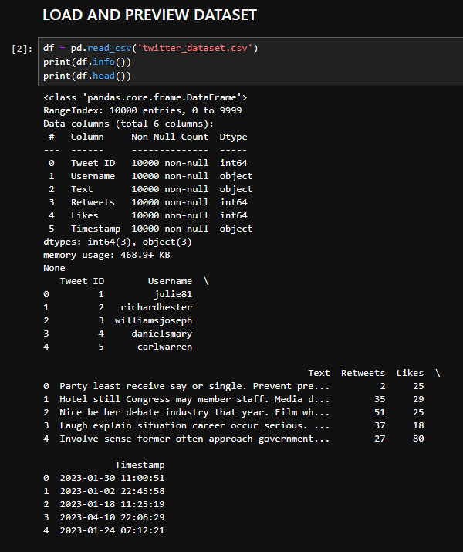
Methodology: An NLP-Driven Approach
The project methodology involves several stages, each integrating NLP principles for effective text processing and sentiment determination.
1. Data Collection
Twitter data can be collected through Twitter's API (if applicable and compliant with usage policies) or by utilizing publicly available datasets. For this project, we assume access to a dataset containing tweet text, user information, and engagement metrics (likes, retweets, timestamps).

Slide 7
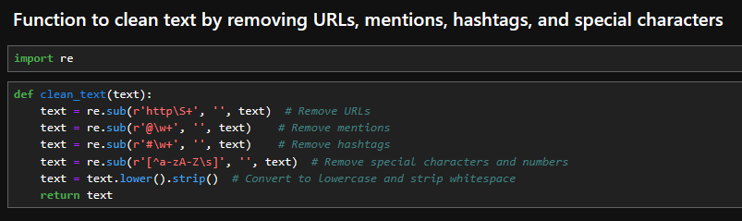
2. Data Preprocessing and Cleaning
Raw tweet data is often noisy and requires extensive cleaning. The preprocessing steps, which are fundamental NLP tasks, include:
Tokenization: Breaking down text into individual words or sub-word units.
Lowercasing: Converting all text to lowercase to ensure consistency.
Stop Word Removal: Eliminating common words (e.g., "the", "is", "a") that provide little semantic value.
Noise Removal:
Removing URLs, mentions (@username), and hashtags (#topic) as they often don't contribute to sentiment directly.
Eliminating special characters, punctuation, and numerical digits.
Lemmatization/Stemming: Reducing words to their base or root form (e.g., "running" to "run") to normalize vocabulary.
This stage results in a Cleaned_Text column suitable for sentiment analysis.

Slide 8
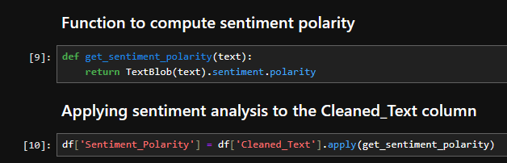
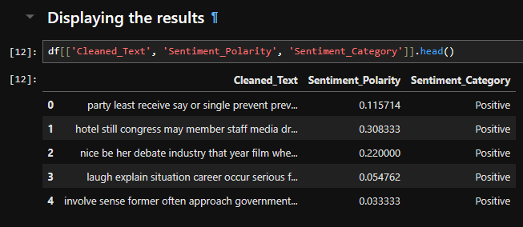
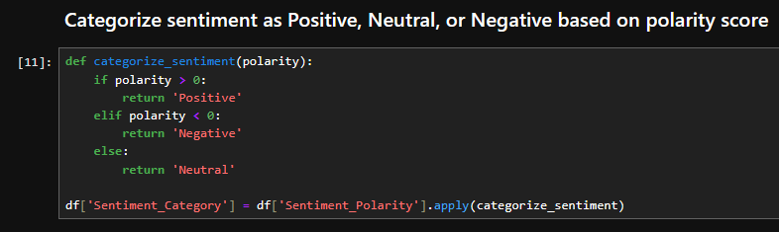
3. Sentiment Analysis Technique
Several NLP-based approaches can be employed for sentiment analysis:
Lexicon-Based Approach: This method uses pre-defined dictionaries (lexicons) of words that are associated with positive, negative, or neutral sentiments, along with their polarity scores. For example, TextBlob is a lexicon-based tool that calculates polarity and subjectivity. Each word in a tweet is scored, and an aggregate sentiment for the entire tweet is derived.

Slide 9
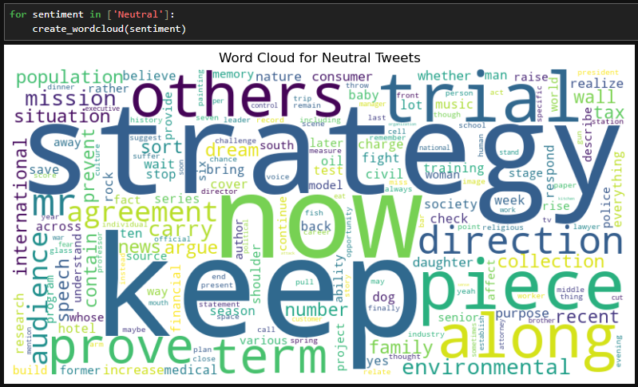
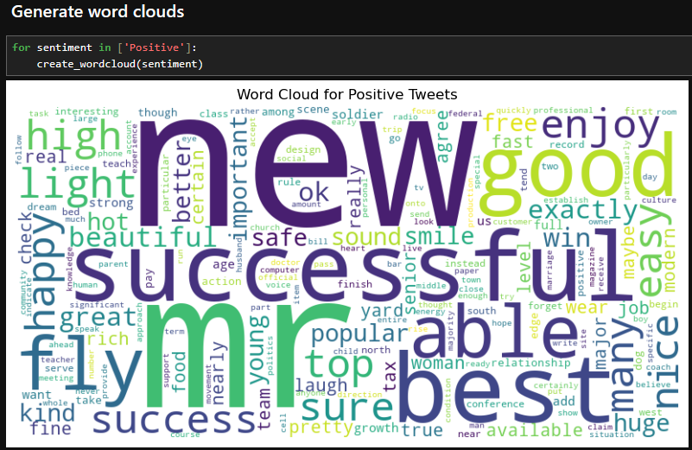
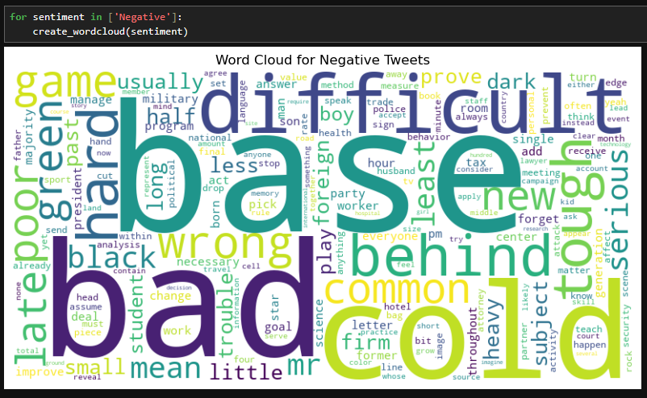
Machine Learning (ML) Approach: This involves training a classification model (e.g., Naive Bayes, Support Vector Machines, Logistic Regression) on a labelled dataset of tweets. Features for the model can be extracted using NLP techniques such as:
Bag-of-Words (BoW): Representing text as a collection of word counts.
TF-IDF (Term Frequency-Inverse Document Frequency): Weighing word importance based on their frequency in a document and rarity across the corpus.
Word Embeddings (e.g., Word2Vec, GloVe): Representing words as dense vectors in a continuous vector space, capturing semantic relationships.

Slide 10
Key Findings and Visualizations
This section presents the insights gained through the sentiment analysis, supported by various visual representations.

Slide 11
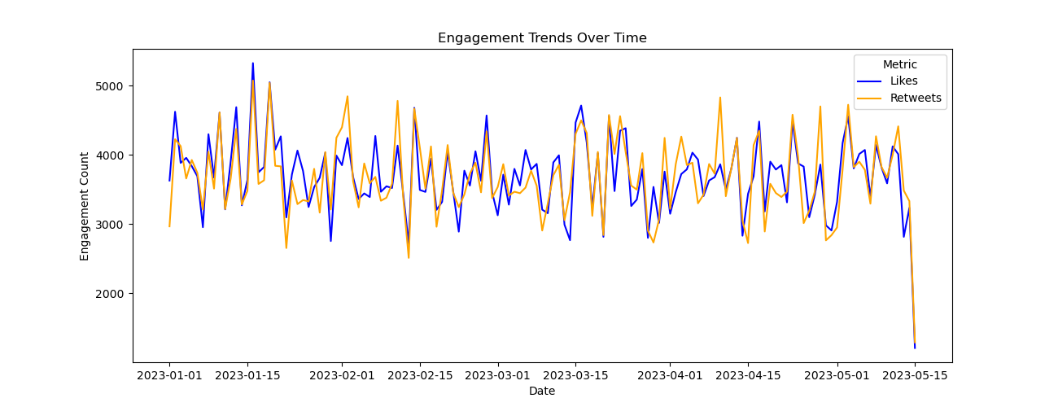
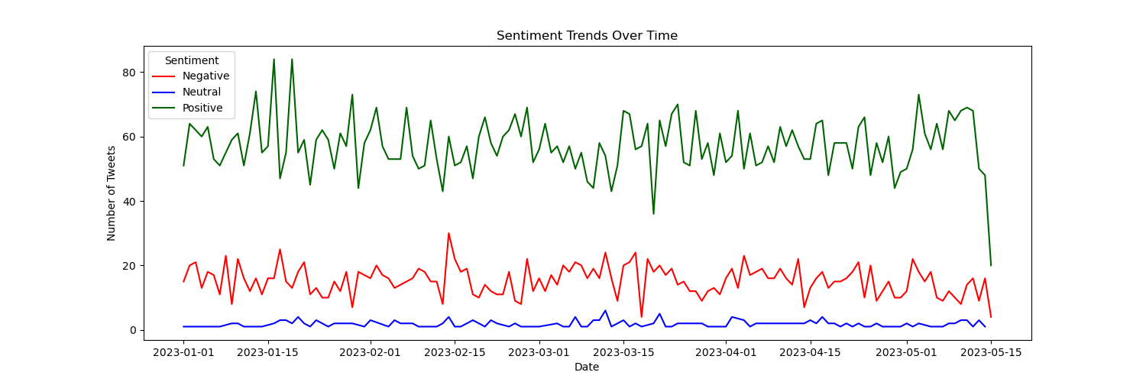
Engagement Trends Over Time
Sentiment Trends Over Time
This line graph displays the aggregated likes and retweets over time, showing the overall engagement patterns.
This line plot visualizes how the sentiment of tweets changes over time, allowing us to identify periods of shifting public opinion.

Slide 12
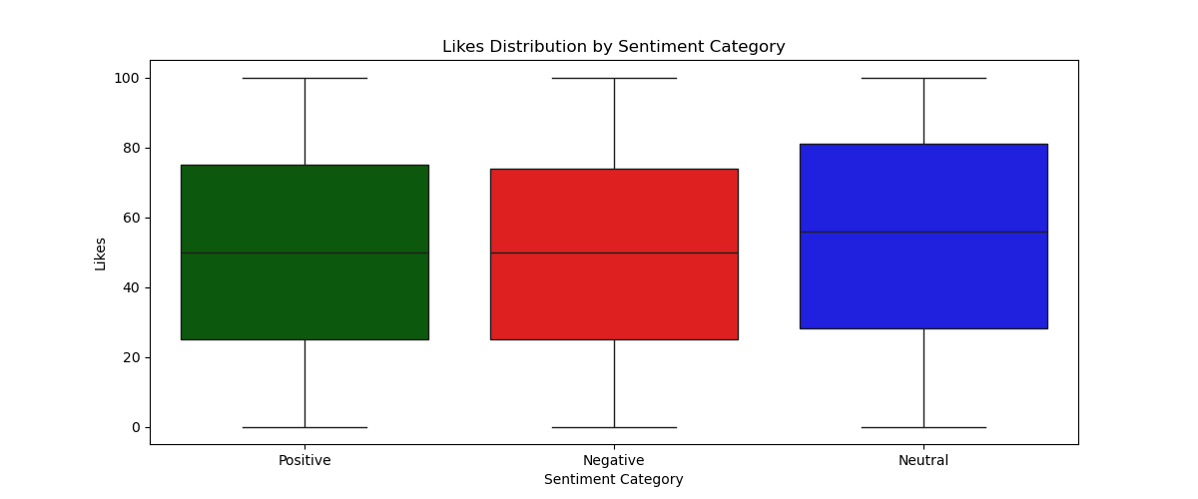
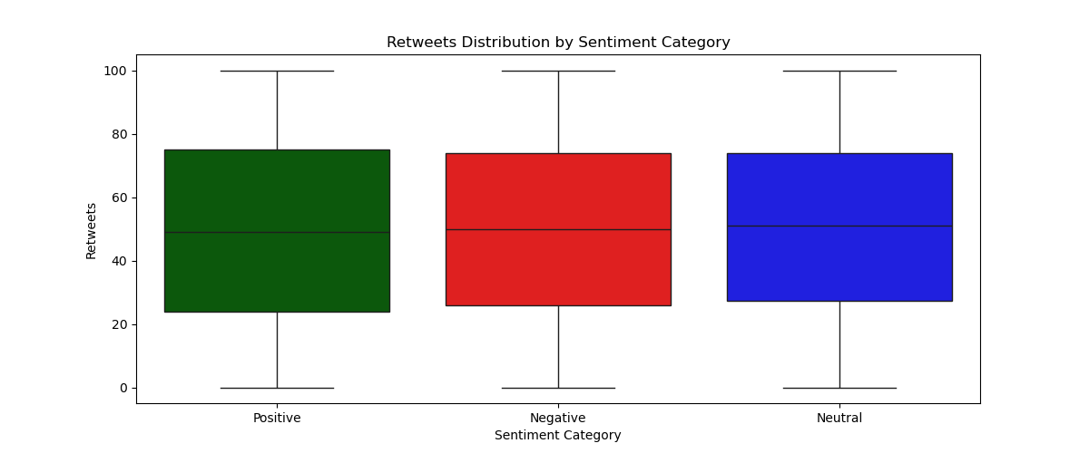
Likes Distribution by Sentiment Category
Retweets Distribution by Sentiment Category
This chart illustrate whether tweets of a particular sentiment tend to receive more or fewer likes compared to others.
This chart illustrate whether tweets of a particular sentiment tend to receive more or fewer retweets compared to others.

Slide 13
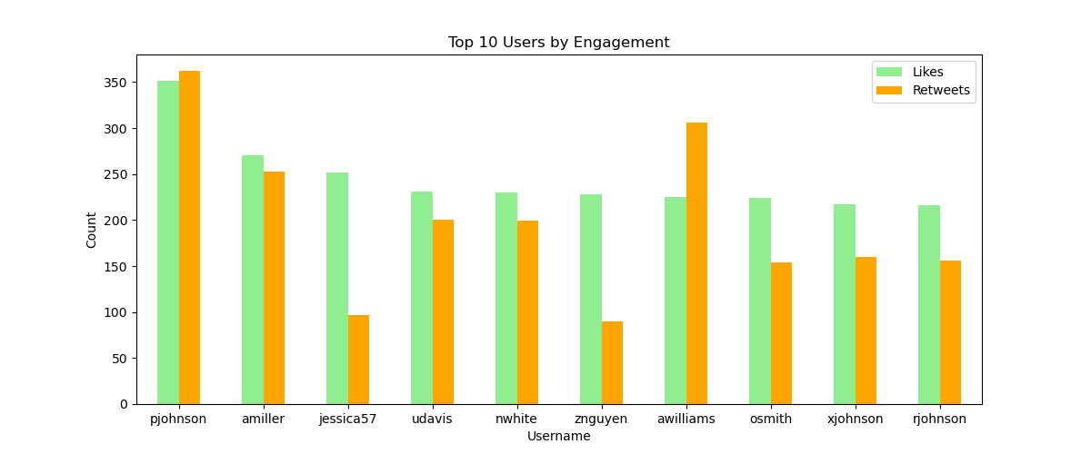
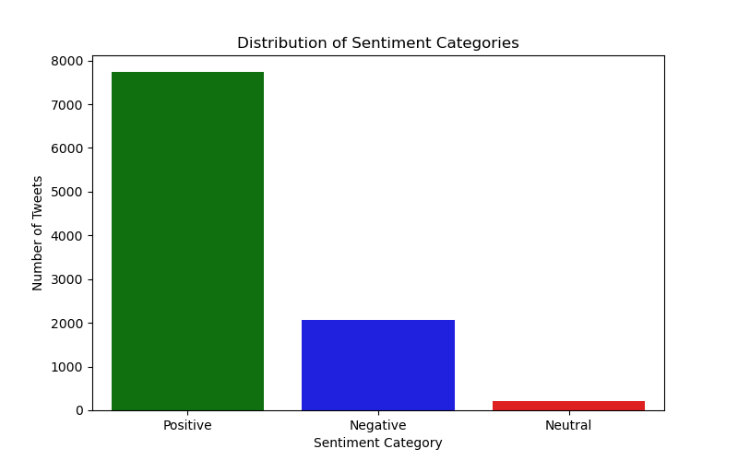
Top 10 Users by Engagement
Distribution of Sentiment Categories
This chart identifies the users who generated the most likes and retweets, indicating their influence and reach within the Twitter dataset.
This bar chart illustrates the overall distribution of sentiment categories within the dataset, showing the proportion of positive, negative, and neutral tweets

Slide 14
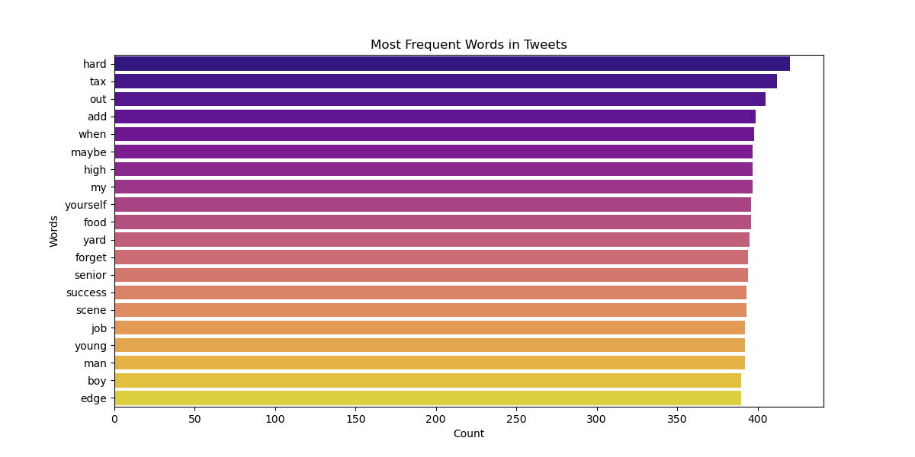
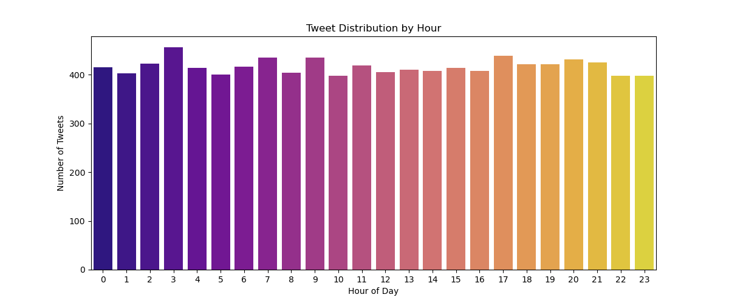
Most Frequent Words in Tweets
Tweet Distribution by Hour
This bar chart highlights the most commonly used words across all tweets after cleaning, providing insight into the general topics discussed.
This chart shows the volume of tweets posted at each hour of the day, revealing peak activity times.

Slide 15
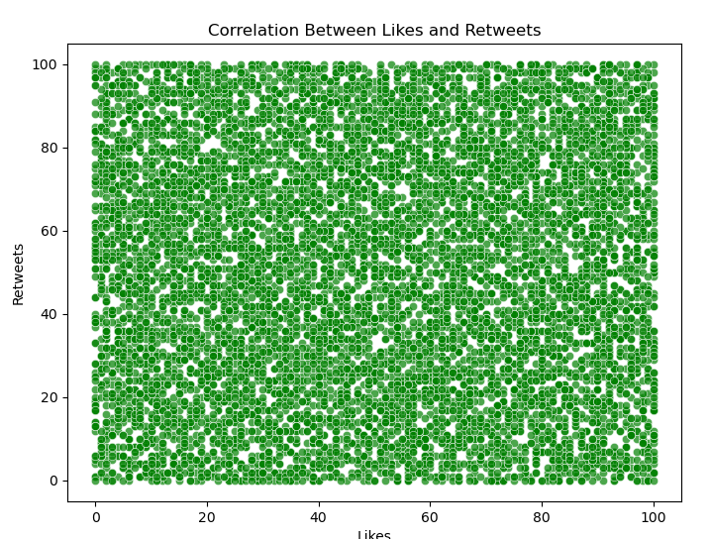
Correlation Between Likes and Retweets
The scatter plot visualizes the relationship between likes and retweets. A numerical correlation coefficient would further quantify this relationship
Correlation Coefficient
 | Likes | Retweets
Likes | 1.000000 | 0.12798
Retweets | 0.012798 | 1.000000

Slide 16
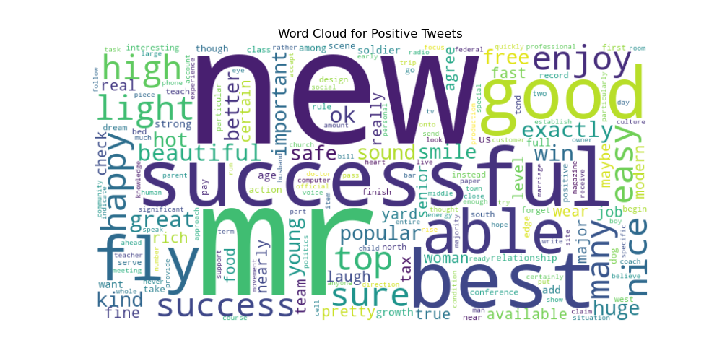
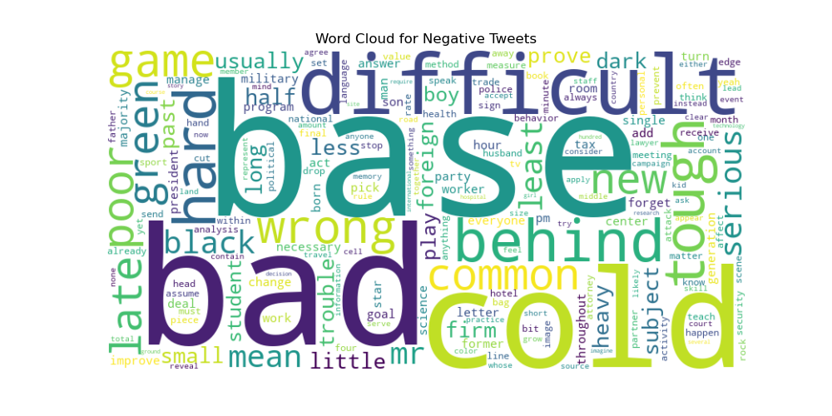
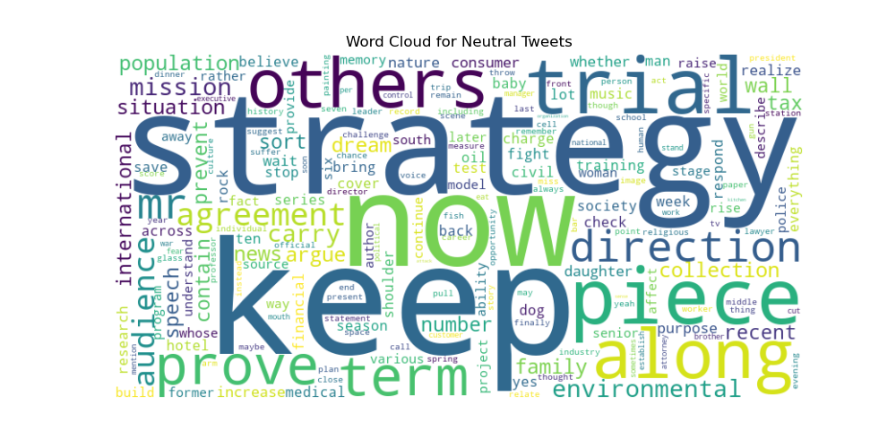
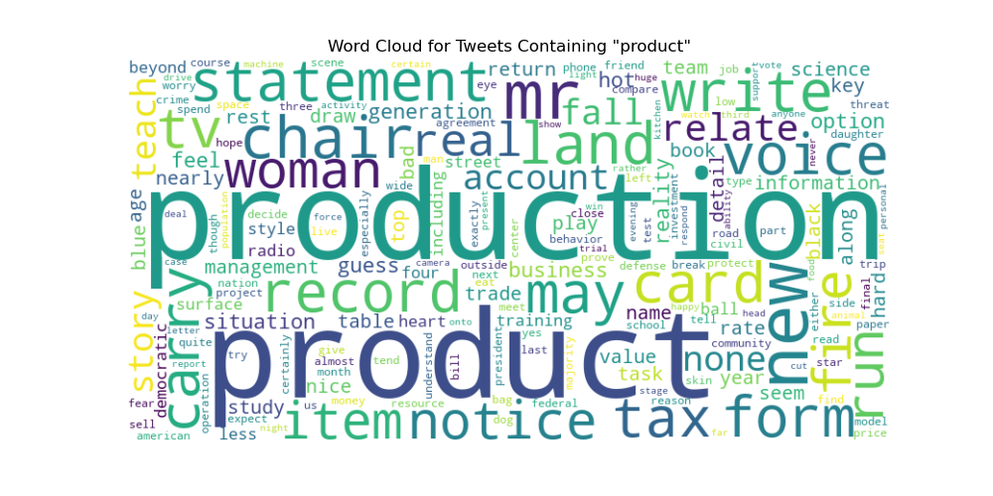
Word Clouds for Sentiment Categories

Slide 17
Conclusion
This Twitter Sentiment Analysis project, leveraging NLP techniques, successfully demonstrates the ability to process raw tweet data, classify sentiment, and extract actionable insights. The visualizations provide a clear overview of sentiment distribution, temporal trends, popular topics, and user engagement patterns. Such analyses are invaluable for businesses tracking brand perception, researchers studying public opinion, and anyone seeking to understand the dynamics of social media conversations. Future enhancements could include exploring more sophisticated NLP models for sentiment classification, real-time sentiment tracking, and integrating named entity recognition for more granular topic analysis.

Slide 18
Thank you
Paromita Saha
Intern Id: ITID0902
paromitasaha0720@gmail.com

